Slide 1
Lecture 16 - Decision Trees and Random Forests
DS 4400: Machine Learning and Data Mining 1

Slide 2
Today
Today
Non-Parametric Models
Entropy Redux
Conditional Entropy
Decision Trees
Random Forests

Slide 3
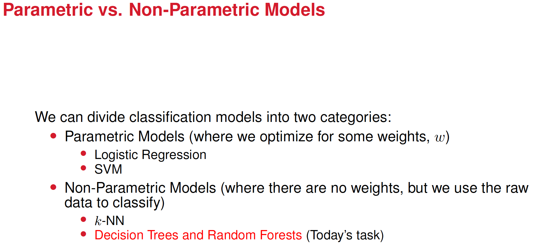

Slide 4

Example of decision tree
Imagine I want to separate y’all into classes. For example, I could separate you by what soccer team do you like (Real Madrid is not allowed, and don’t get me started on why), and by whether you like espresso, and whether you rock climb, or play tennis, or like to read.
Imagine we have these features then
Soccer Team (except Real Madrid), Rock Climbing, Tennis, Espresso, Read
We have a sample of 24 students
We then can do(next page)

Slide 5
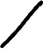
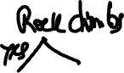
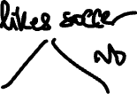
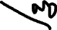
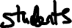

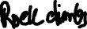
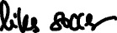
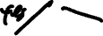

The first node is about liking or not espresso

Slide 6
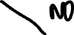
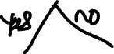
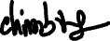
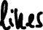
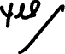
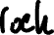
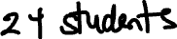
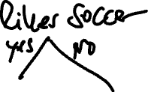
The first node is about liking or not rock climbing

Slide 7
Which splits creates a more skewed distribution?
Splitting by liking rock climbing: 23 students like rock climbing vs. 1 who does not like it
Splitting by liking espresso: 12 students like espresso and 12 students don’t like espresso
Which splits reduces uncertainty?
Which splits provides more information?
So, which split is preferred then?

Slide 8
Which splits creates a more skewed distribution?
Splitting by liking rock climbing: 23 students like rock climbing vs. 1 who does not like it
Splitting by linking espresso: 12 students like espresso and 12 students don’t like espresso
Which splits reduces uncertainty? splitting by liking rock climbing
Which splits provides more information? splitting by liking rock climbing
So, which split is preferred then? splitting by liking rock climbing

Slide 9
So now, remember Entropy?
Entropy measures uncertainty. The larger the uncertainty the larger the entropy
Which splitting reduces uncertainty then (reduces entropy)? The splitting by liking rock climbing
When building this tree, it’s convenient to do splits that reduces uncertainty, as this brings us to the solution (in this case classification) faster
We will review entropy next and introduce a new concept, information gain. Information gain is related to both entropy and conditional entropy. We want the splits to increase information gain

Slide 10
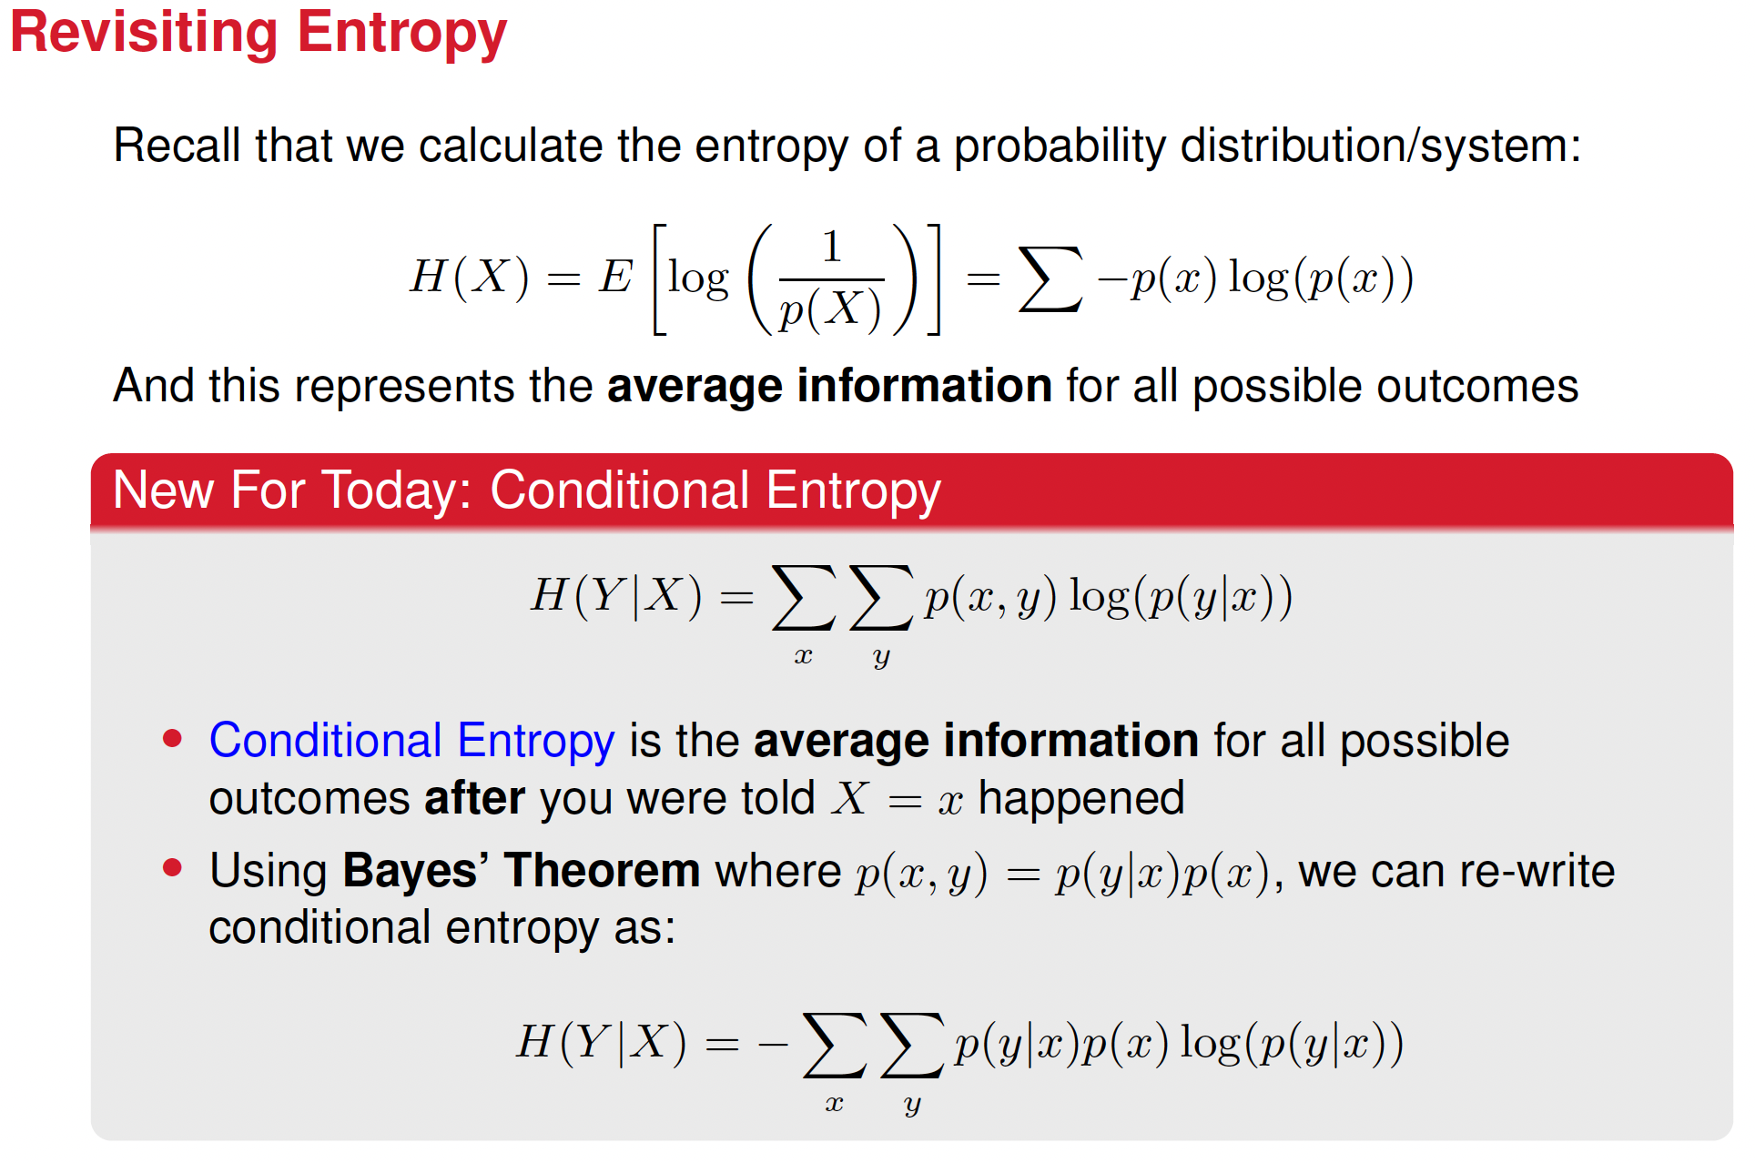
Notes:
Include a note here about the Bayes theorem. There’s a minus missing too in the first expression

Slide 11
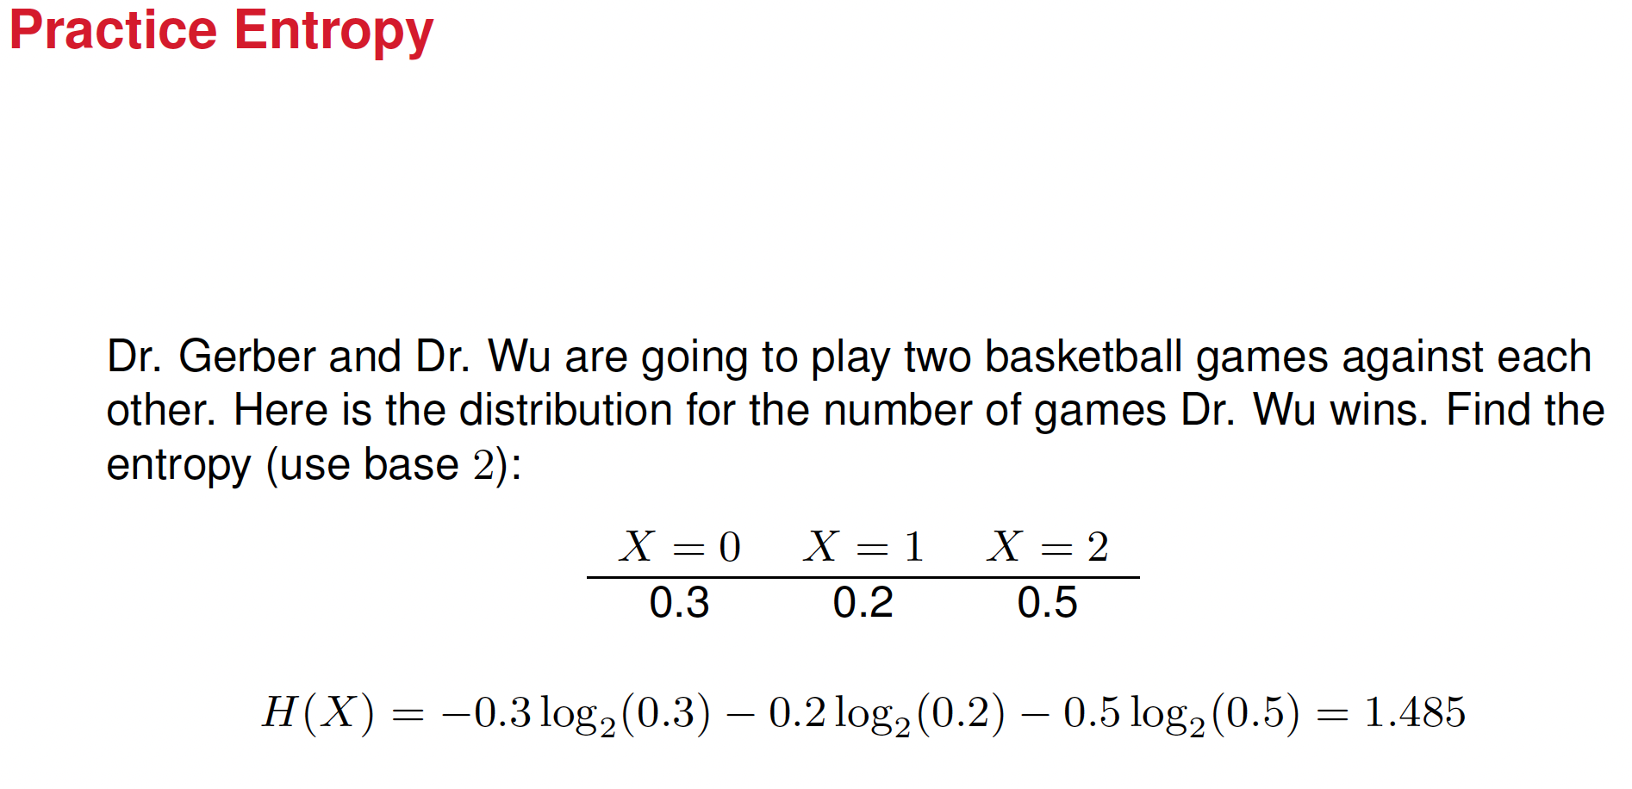
Notes:
Maybe hide the answer first

Slide 12
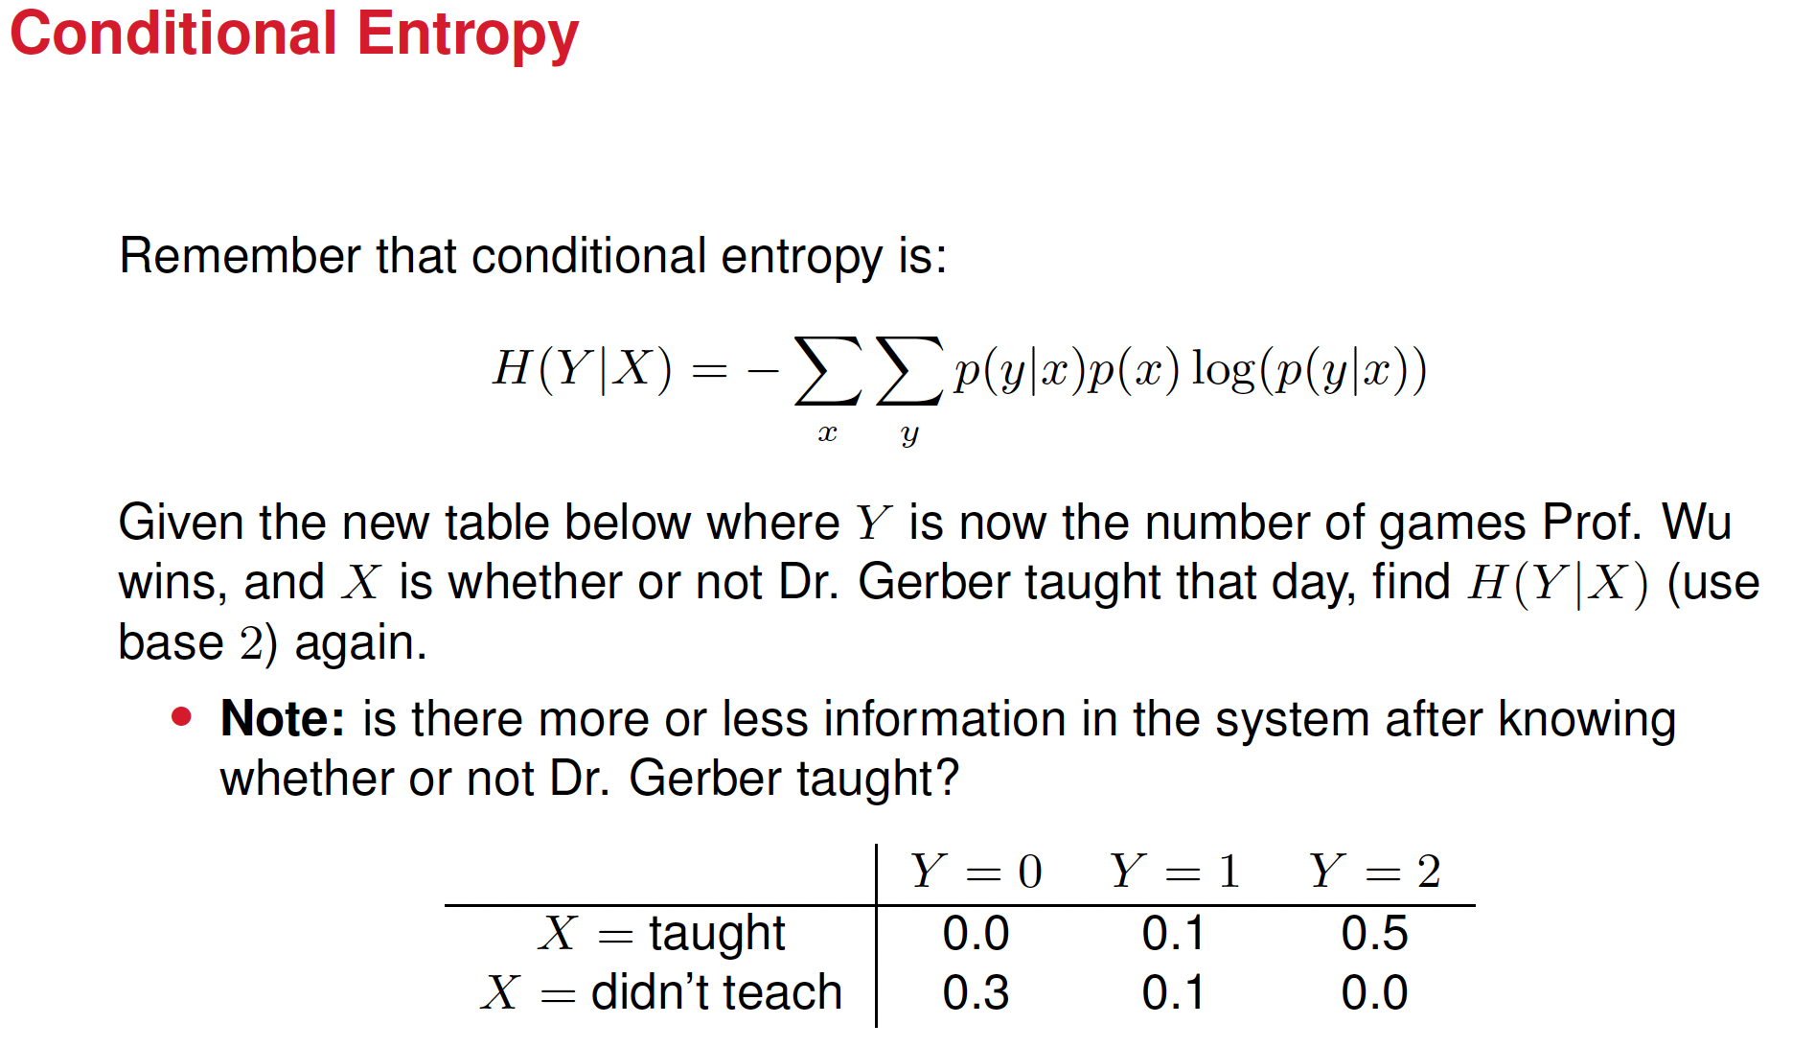
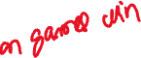
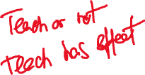
Notes:
Solve this example

Slide 13
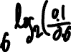
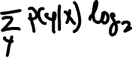
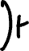
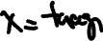
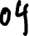
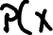
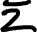
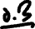
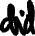
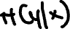
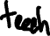
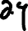
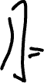
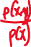
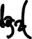
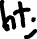
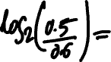
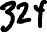
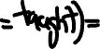
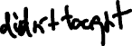
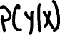
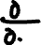
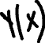
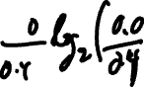
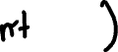
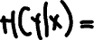
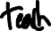
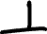














Slide 14













Slide 15


Notes:
Solve this too, if needed

Slide 16





































Slide 17


Slide 18
The goal of a decision tree is to create branches that are as pure as possible.
Purity means that most samples within a branch belong to the same class. This lowers the conditional entropy.
When the probabilities are more skewed, the conditional entropy is lowered because there’s less uncertainty.
Split on "Taught"
When we split based on "taught," the class distribution is:
[0.0, 0.1, 0.5 ] (very skewed toward Y = 2)
[0.3, 0.1, 0.0] (very skewed toward Y = 0)
Split on "Rain"
When we split based on "rain," the class distribution is more balanced:
[0.1, 0.1, 0.3]
[0.2, 0.1, 0.2]
When the probabilities are skewed, one branch of the tree could be almost pure. The conditional entropy is then almost zero. This can create a larger gap between the original entropy and the conditional entropy, which increases the information gain.

Slide 19


Slide 20





Slide 21

ds4400_clean_gtky.csv

Slide 22

Notes:
Show how to compute H(Y). Where’s the big table?

Slide 23



Slide 24


Slide 25













Notes:
Work out H(Y|X<1.5) and H(Y|X>1.5)

Slide 26


Slide 27


Slide 28


Slide 29


Slide 30


Slide 31


Slide 32


Slide 33
Conclusion
• Work hours are the main driver of co-op participation.
Students with > 1.5 work hours are usually in co-op.
Students with ≤ 1.5 work hours are mostly not in co-op.
• Class standing (Senior) adds limited refinement.
Seniors working few hours are slightly more likely to be in co-op, but the pattern is inconsistent.
Non-seniors show mixed behavior, especially at higher work hours.
• Credit hours contribute little to prediction.
Splits on credit hours barely reduce entropy or improve accuracy.
Overall pattern:
If work_hours > 1.5 → predict co-op; else → predict not co-op.
Lower splits fine-tune predictions but don’t add much information.

Slide 34


Slide 35


Slide 36


Slide 37


Slide 38


Slide 39
Decision Trees
Training Phase (Learning)
The model analyzes labeled data to learn decision rules.
Each split is chosen to reduce entropy (gain the most information).
The result is a decision tree that captures how features predict outcomes.
Inference Phase (Prediction)
A new sample enters the tree and travels through feature-based questions.
The leaf node provides the final prediction (majority class at that leaf).

Slide 40
Random forest
Each tree is trained on a different random subset of data and features.
During prediction, each tree votes for a class.
The majority vote wins, making predictions more stable and less biased.
It’s like many people giving independent opinions: the group decision is final.

Slide 41


Slide 42
Accuracy in Classification Models
The accuracy of a classification model measures how often the model correctly predicts the target class.
Accuracy = (Number of Correct Predictions) / (Total Number of Predictions)
Or equivalently:
Accuracy = (TP + TN) / (TP + TN + FP + FN)
TP = True Positives
TN = True Negatives
FP = False Positives
FN = False Negatives
High accuracy means the model is often correct.

